Slide 1
Employee churn model analysis– Non-Technical Presentation
Date: 03/02/2020
Presenter: Prahlad Lama

Slide 2
Rising Churn (↑ 20% YOY) are increasingly contributing to hiring cost (+25% YOY) and decline in time based productivity , requiring reduction in Churn Rate to reduce this impact in both the short and long term.
!
Star line Co. Churn rate increased 20% from last year in western division in California and finding and replacing these employees ended up having 25% costlier than before
Star line Co. inability to take action on alarming churn rate of +20%, resulted in loss of its over 10% of employees count
!
Star line Co. Has yet no clear picture of the
drivers that have caused the recent churn
HR department have employed increasing benefits and have recommended Analytics team to find potential factors that can help increase retention and reduce Churn.

Slide 3
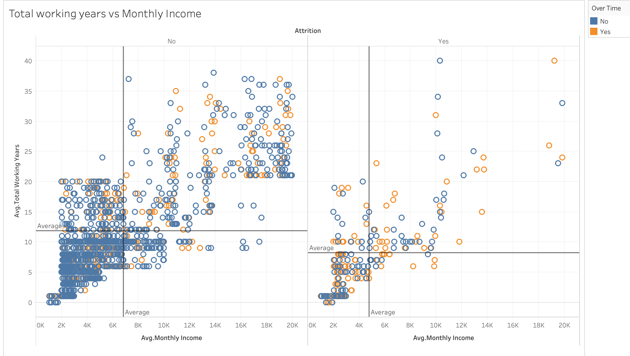
Through a combination of visual and statistical methods, we identified three key variables: Monthly Income, Overtime & Total working Years were associated with Employee leaving(Attrition) the company. .
Key Insights
Overtime : Employees who work overtime (30.5%)¹ are highly likely to leave the company than who don’t (10.4%)¹
Monthly Income: Employees who make less than $4.7K (46.8%)²on average are likely to leave than those making $6.8 k or higher monthly income.
Total working Years: Employees who works less than 8.2 years(42.5%)² on average are highly likely to leave the company than those working more.
Avg.Monthly Income:$6.8k
Avg.Totalworkingyrs:11.8 yrs
Avg.MonthlyIncome:$4.7K
Avg.Totalworking years:8.2 yrs
Source: Star line Co.Statistical Records
1.Refer to Slide 8 barplots where Leavers % Over Time (30.5%)
2.Refer to cap_2 python HR

Slide 4
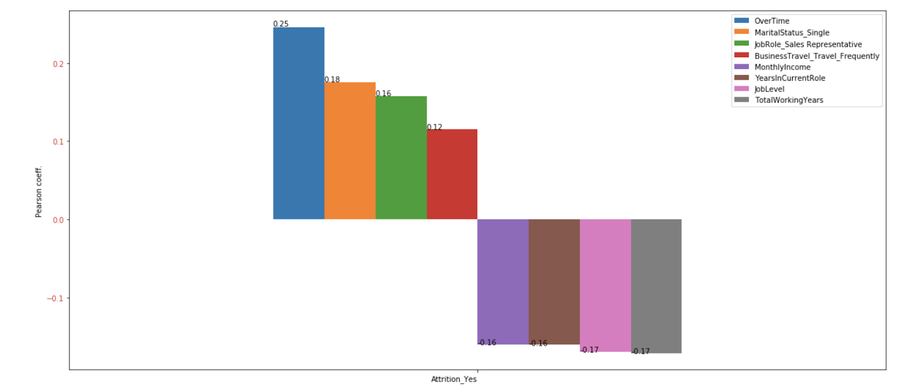
From high level statistical analysis, we found that variables :Overtime, Single, Total working Years, Sales Representative ,Job level, Years in current Role , Monthly Income and Business Travel, all have a strong association with Employees leaving.
Key Insights
Through utilizing a measure known as correlation we’ve identified variables which indicates how closely a variable is related to Employees Churn(leaving)
Employees who are Sales Representative ,work Overtime, are Single, and make Business Travel frequently strongly relate to leaving from those who don’t.
Employees with Lower values of Total working Years, Job level, Years in Current Role, Monthly Income strongly relate to leaving than those with higher values.

Slide 5
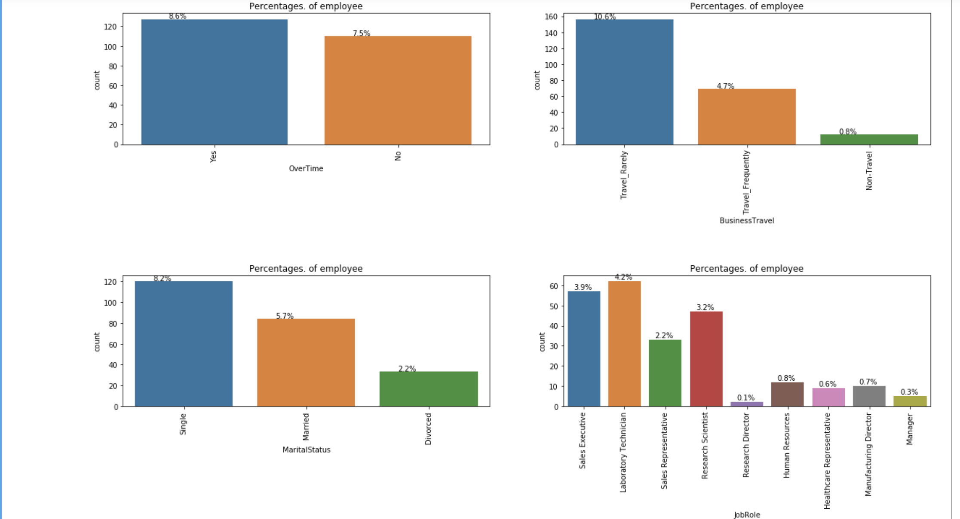
Contrasting both condition of employees leaving and staying through visualization methodology we can see close association of employees leaving with variables: Employees working Overtime, who are Single, as Lab Technician and who Travel Rarely.
Key Insights
Job Role: Lab Technician are the highest leavers(4.2%) out of all Job Roles.
Single employees make up the highest leavers (8.2%) than Married(5.7%) and Divorced(2.2%)
Over-timers are more prone to (8.6%) leaving than who aren’t(7.5%).
Employees who travel rarely make up biggest chunk of Leavers(10.6%) but within subgroup who Travel Frequently are more likely to leave²
Count plots with Percentage of Employees who left
1:Rerer to Slide 7 barplots where Leavers %,Sales Rep(39%) and Lab Technician(23%)
2:Refer to Slide 8 barplots where Leavers % Business_travel_frequently (24.91%)

Slide 6
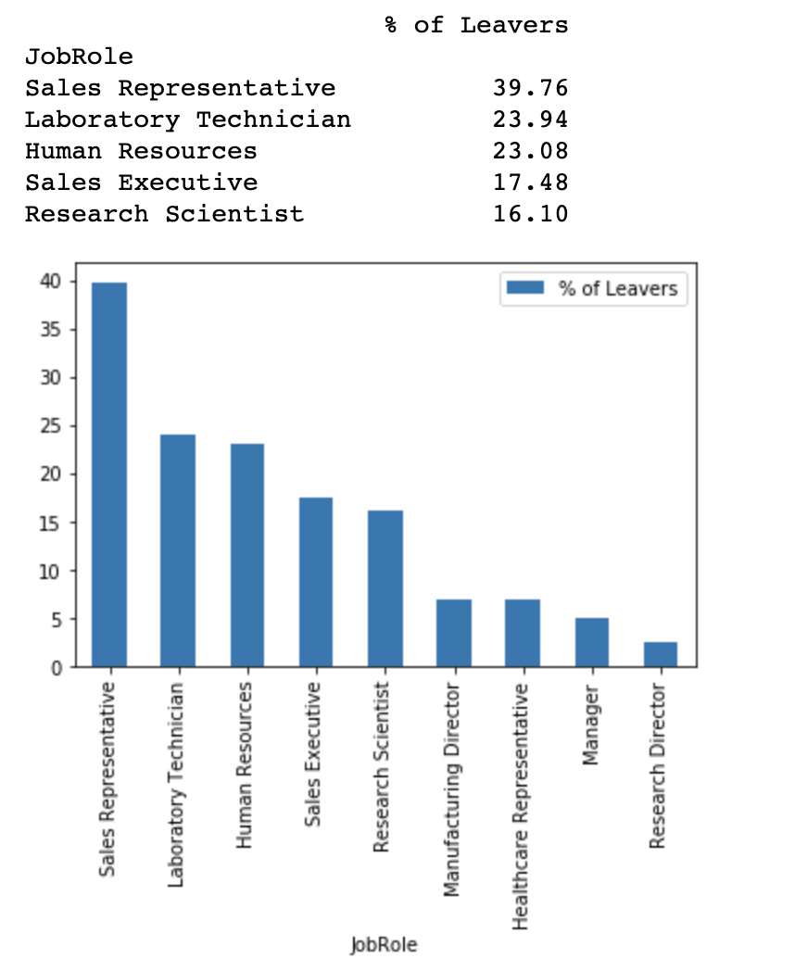
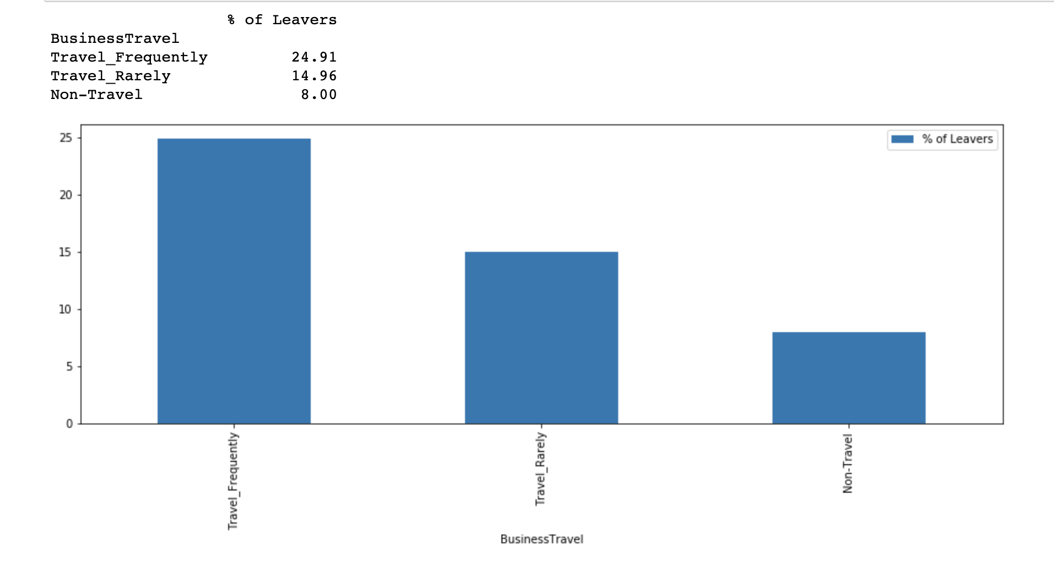
From visualization of Job Roles and Business Travel, Majority of Company leavers are :Sales Rep & Lab Technician within all Job Roles and Travel frequently
Key Insights
Sales Representative have the highest (39%) leavers followed by Laboratory Technician(24%) and Human Resources(23%)
Employees who Travel Frequently (25%)are likely to leave than who travel rarely(15%) and who don’t travel(8%).

Slide 7
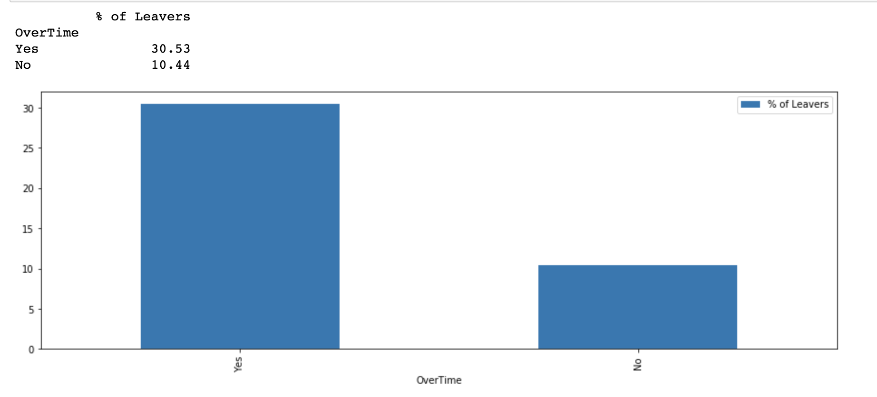
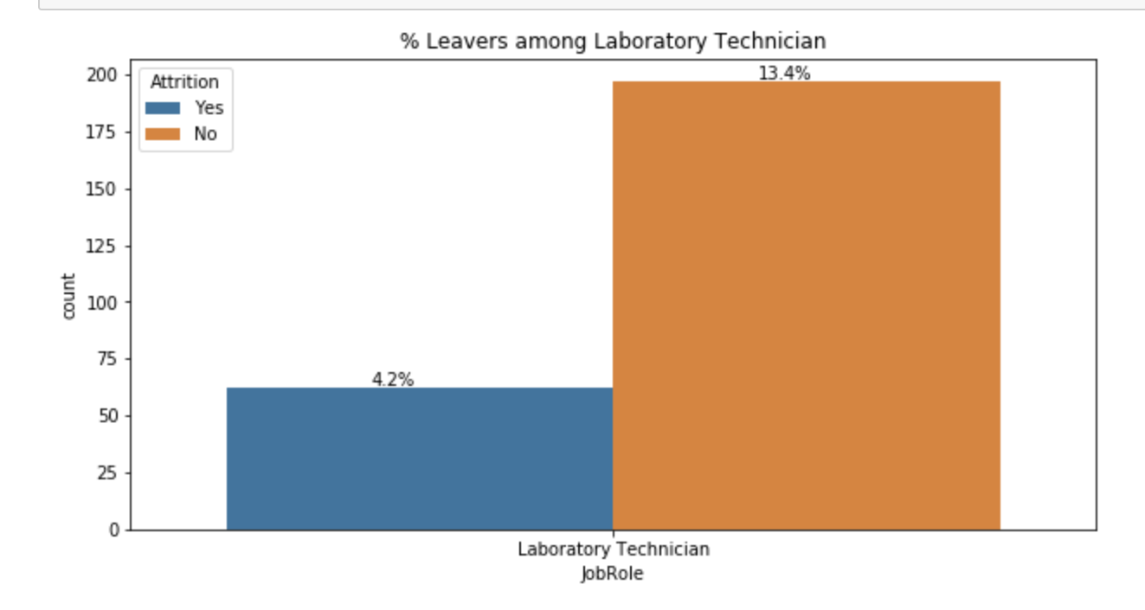
From visualization of Overtime & Job Roles, Employees who work overtime & are Lab Technician are most likely to leave the company than who don’t.
Key Insights
Employees who work overtime(30%) of them left than those who didn’t account for only 10%.
Employees who work overtime out of all employees is 28.3%
Lab Technician who Churn make up 4.2% of total employees

Slide 8
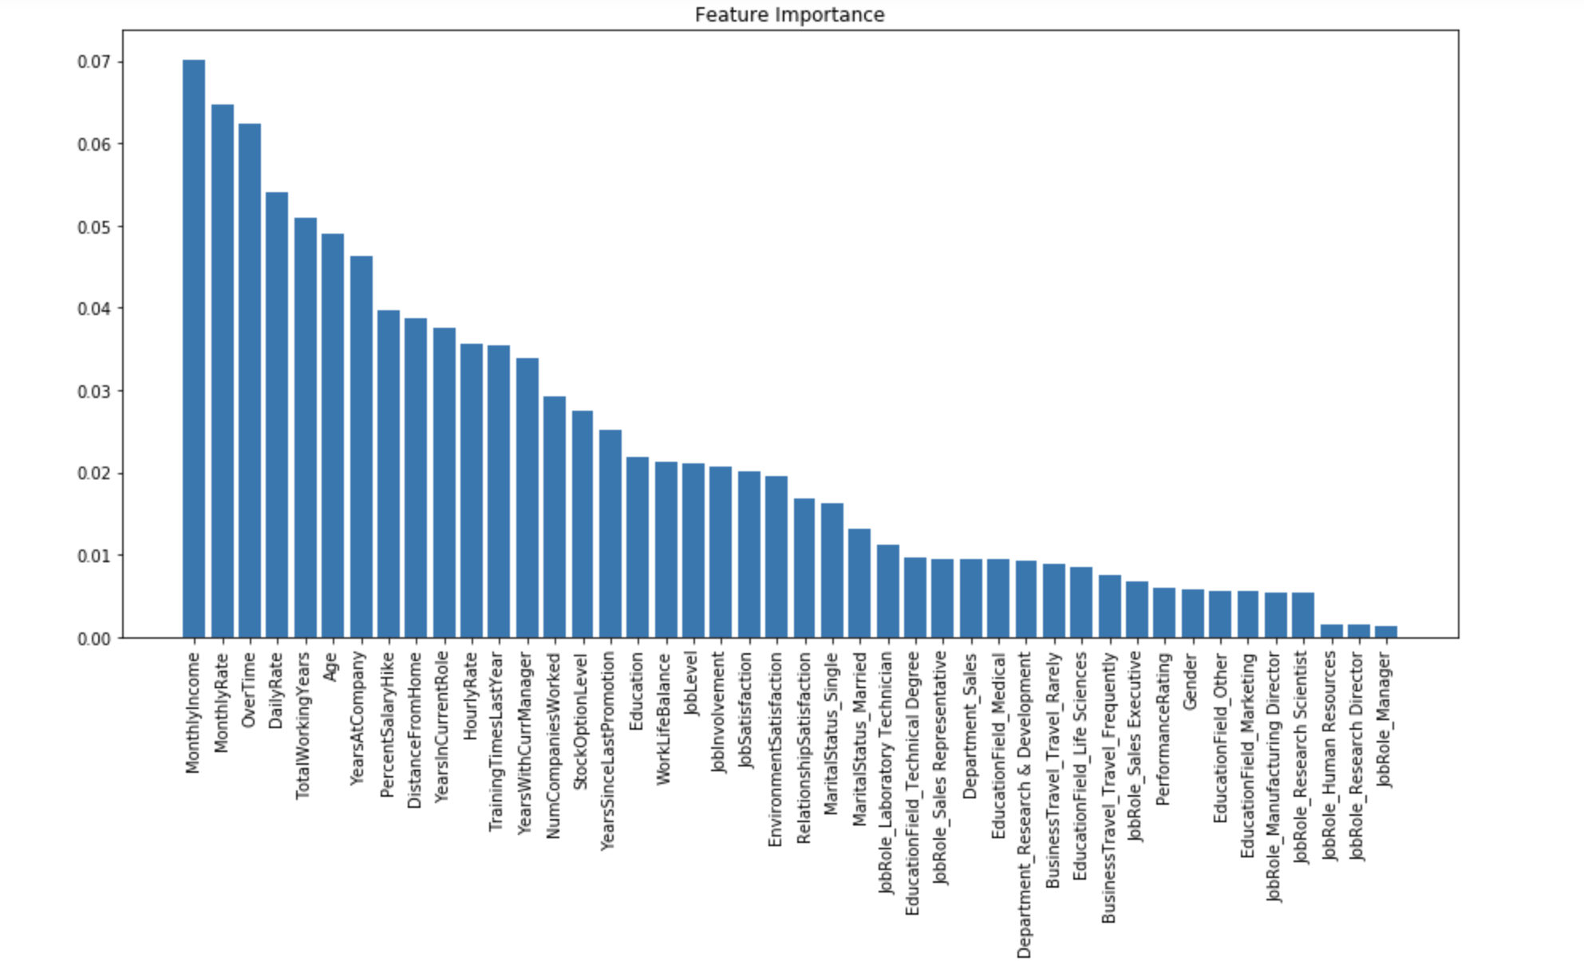
Employing high level statistical model we identified these top 5 core variables associated with Employees leaving(attrition) based on their importance : Monthly Income, Monthly Rate, Overtime, Daily Rate & Total working Years
Key Insights
The feature importance of our model shows that Monthly Income, Monthly Rate, Overtime, Daily Rate and Total working Years are top features predicting Churn
Out of these features Monthly Income, Over Time & Total working years also showed strongest correlation with our target variable Attrition¹.
1:Rerer to Slide 5

Slide 9
A strategic "Retention Plan" should be formulated for each Risk Category group by HR in conjunctions with involvement of HR Representative and Employees Union members.
Key Recommendations
Monthly Income: Employees on higher wages are less likely to leave the company. Hence, efforts should be made to gather information on industry benchmarks in the current local market to determine if the company is providing competitive wages.
Over Time: Employees who work overtime are more likely to leave the company. Hence efforts must be taken to appropriately scope projects upfront with adequate support and manpower so as to reduce the use of overtime.
TotalWorkingYears: The more experienced employees are less likely to leave. Employees who have between 5-8 years of experience should be identified as potentially having a higher-risk of leaving.Hence efforts should be made to them to reward financially or provide recognition of their work .
Flexible working hours for Employees who travel frequently
Risk Category: High: Medium: Low see Python notebook Capstone2_HR analytics.ipynbcluster analysis

